Slide 1
Lopez Urban Farm Interactive Map
Christian Orozco, Caleb Szeto, Thet Wai, Elijah Rosal, Cooper Nathan

Slide 2
01
Background and Topic

Slide 3

What Problems Need Addressing?
New visitors may be confused
Not much information on the web about the areas around the farm
Volunteers not always available to answer questions

Slide 4
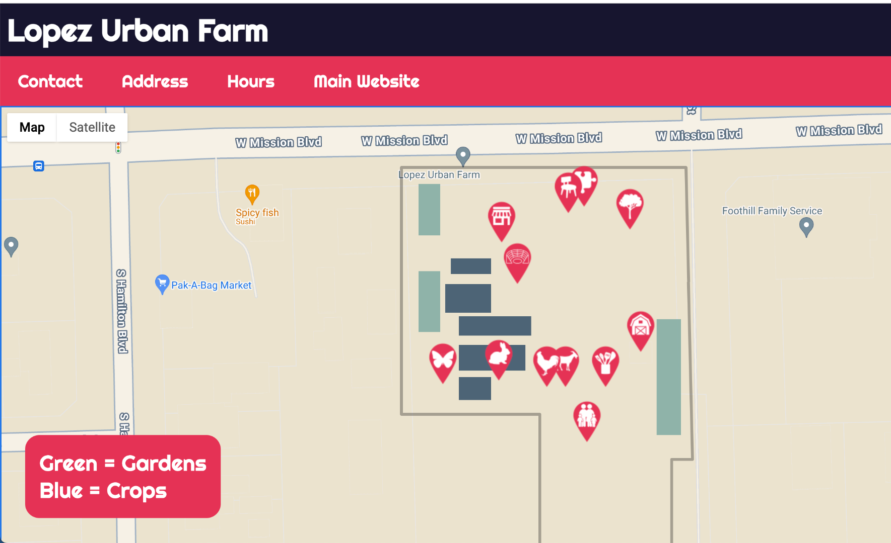
Our Solution
An interactive map containing relevant information
Includes brief descriptions about areas around the farm
Reduce questions about the farm

Slide 5
02
Utility

Slide 6
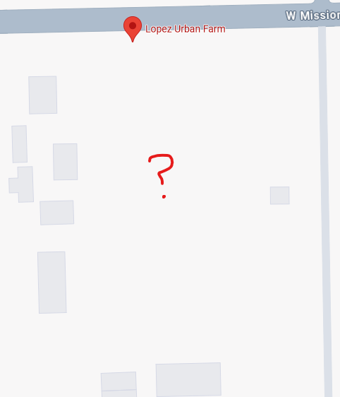
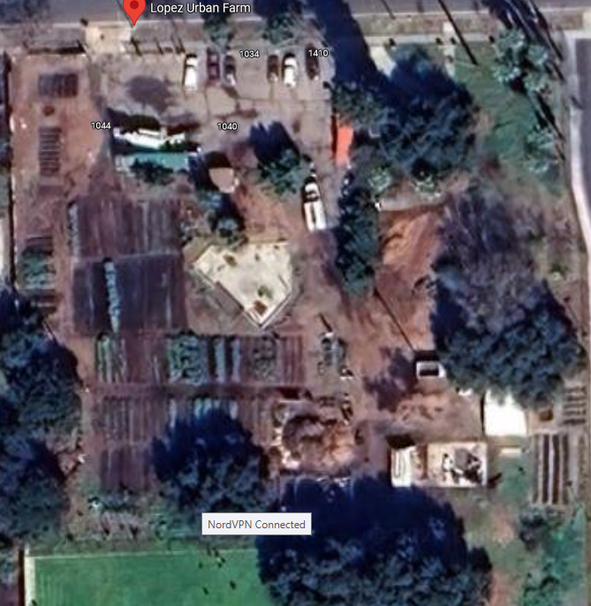
Current Map Coverage
Lacking Information
Out of date / hard to understand

Slide 7
How does the project improve operations?
For Volunteers
For Visitors
Reduces questions from visitors
Allows them to focus more on their tasks without the need for them to guide visitors
Allows for self-guided exploration
Provides detailed information about all areas of interest

Slide 8
03
Implementation

Slide 9

Tools Used
Github Pages = Hosts our current website
Javascript = Functionalities and putting the landmarks
css, html = Styling the page
Google Maps API = Getting the Google Maps and custom layout map
Render= Hosts the proxy server for retrieving Google Maps API

Slide 10
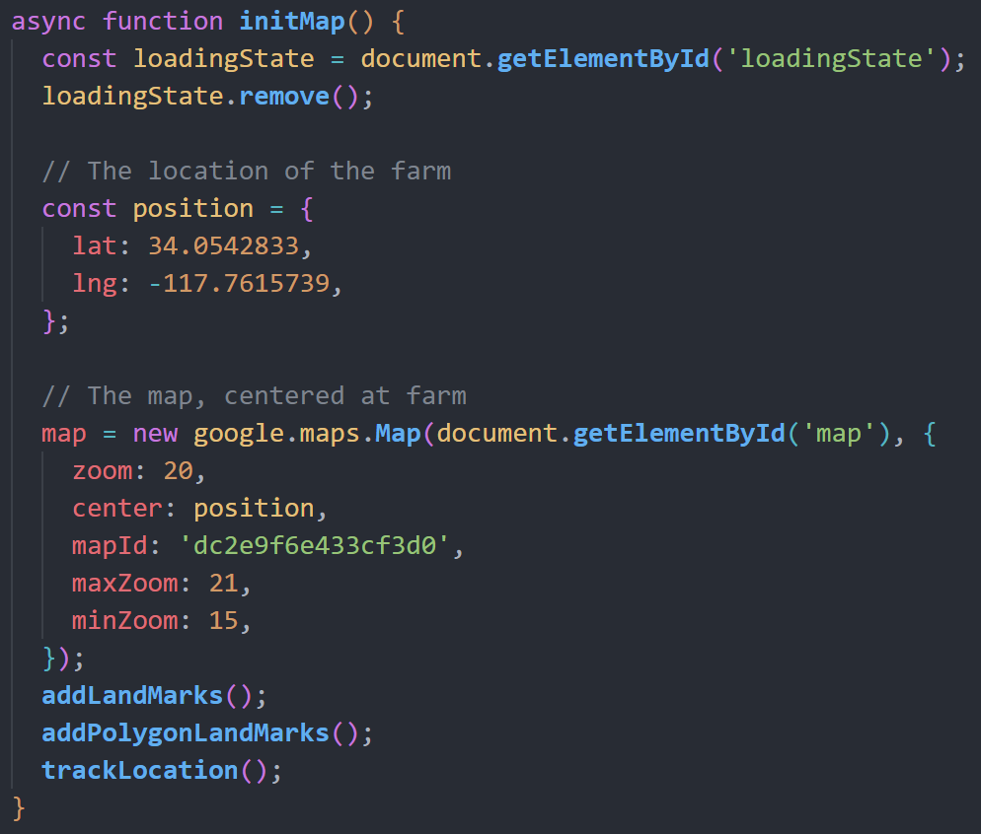
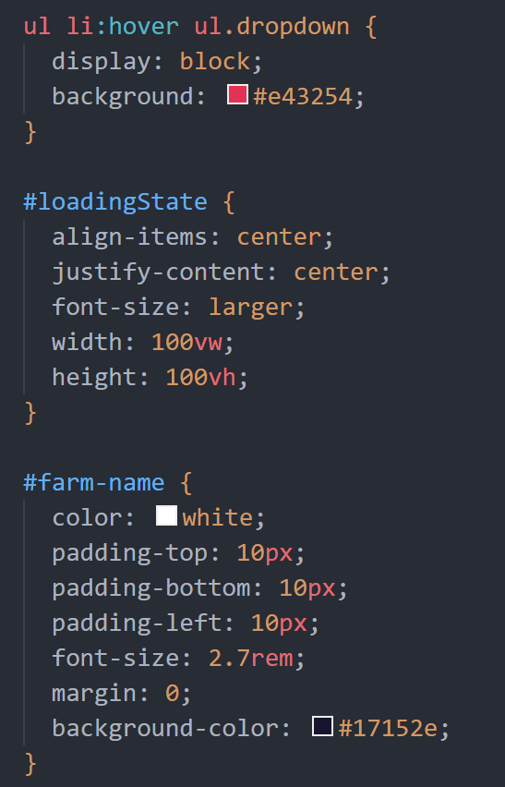
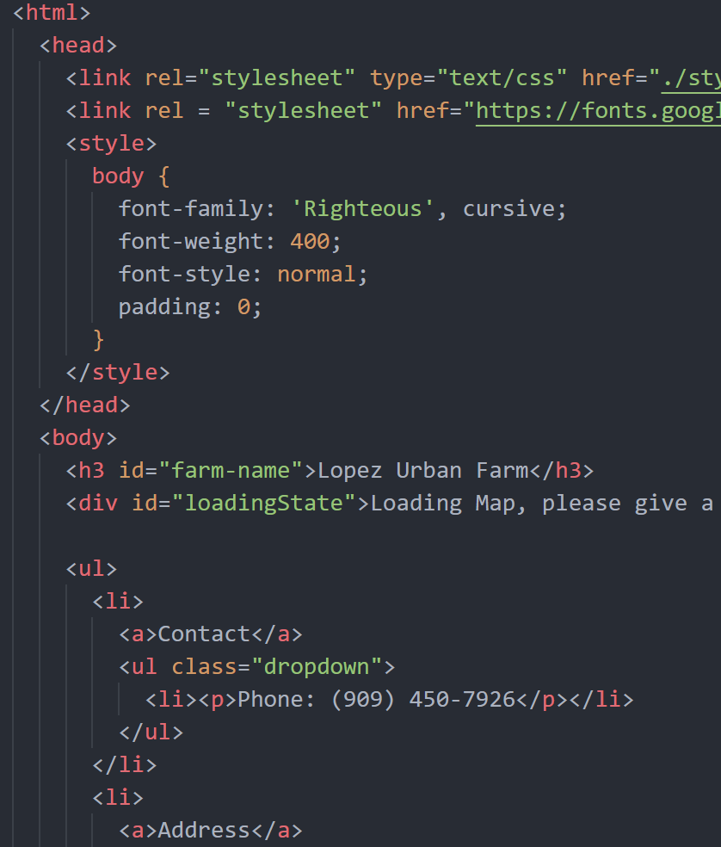
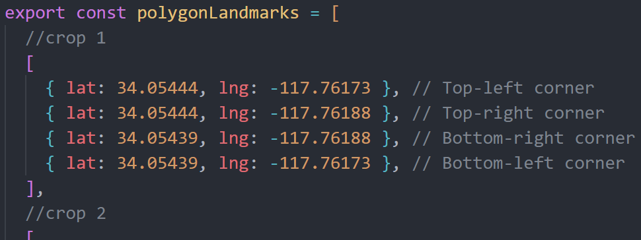
Code Samples
main.js
style.css
index.html
FarmInfo.js

Slide 11
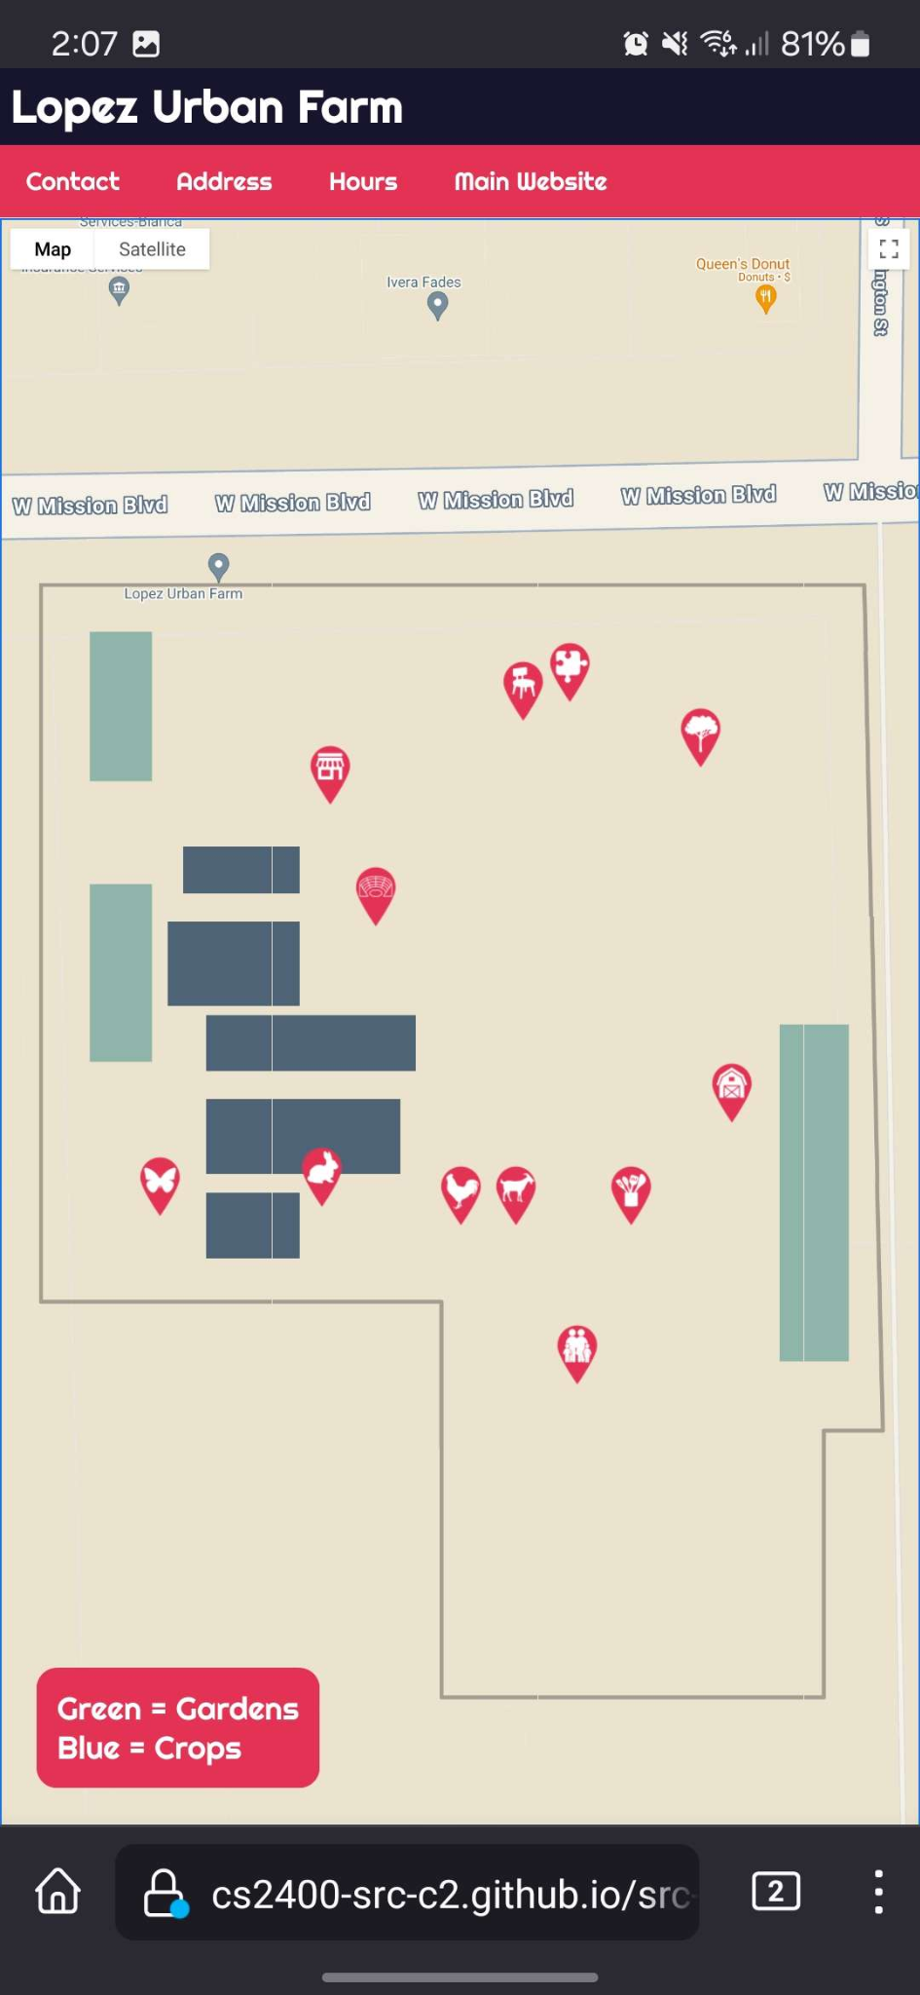
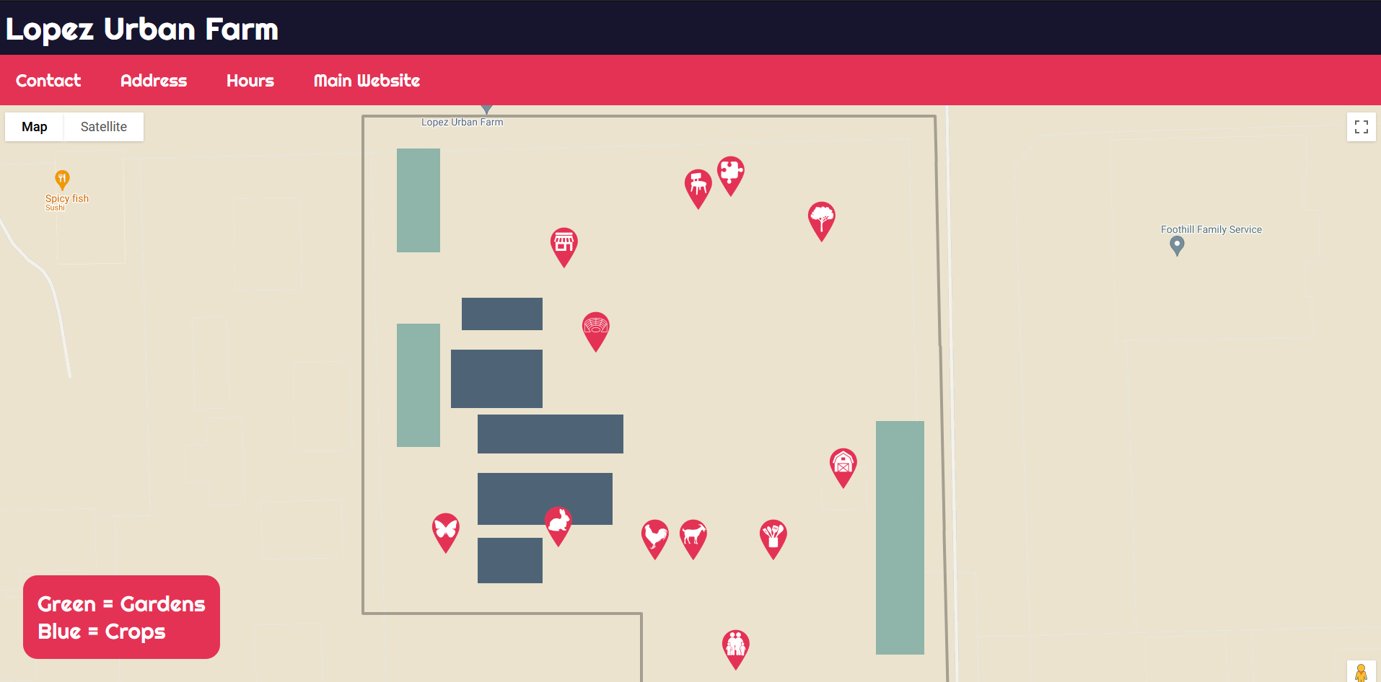




Interface
Icons denote Landmarks
Polygons denote Crops / Gardens

Slide 12
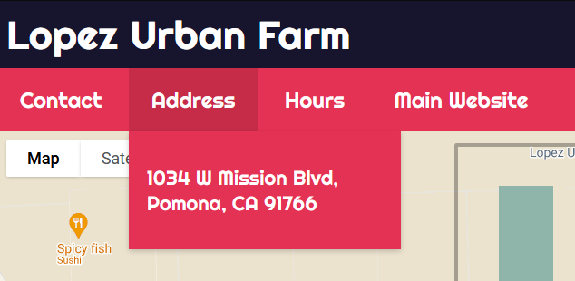
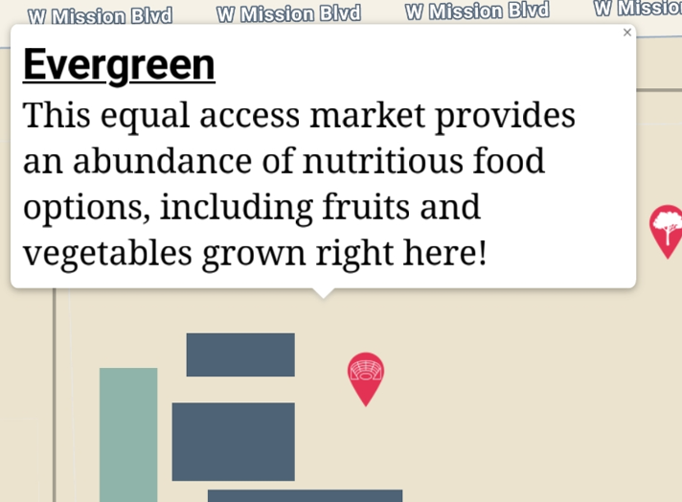

Interface
Visitors could access via QR code at farm entrance
Click / tap Icons and crops for more information
Hover mouse or tap menu bar for more information about farm and a link to their main website

Slide 13
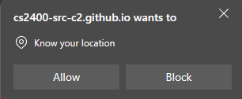
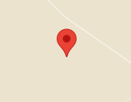
Interface
Location tracking
The built-in Google Maps location tracker doesn’t detect small distances like walking so we had to go for an alternative
Pin updates every 5 seconds
Time interval could be adjusted but increasing it causes the device to quickly heat up

Slide 14
04
Improvements

Slide 15
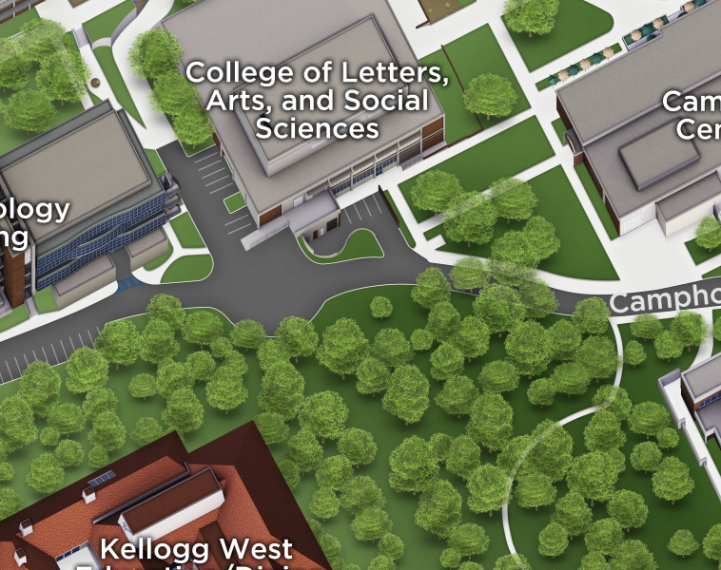
Landmark and Crop Visuals
Visuals to denote buildings and structures represented by landmark pins
Google maps polygons are limited, custom pins and images could be used
Loading Times
Upgrade proxy server
Add a short video or info screen to mask loading times
Database integration
Store crop info/locations in a database, allows more security and live changes just by changing the database without having to redeploy it.

Slide 16
The End

